Slide 1
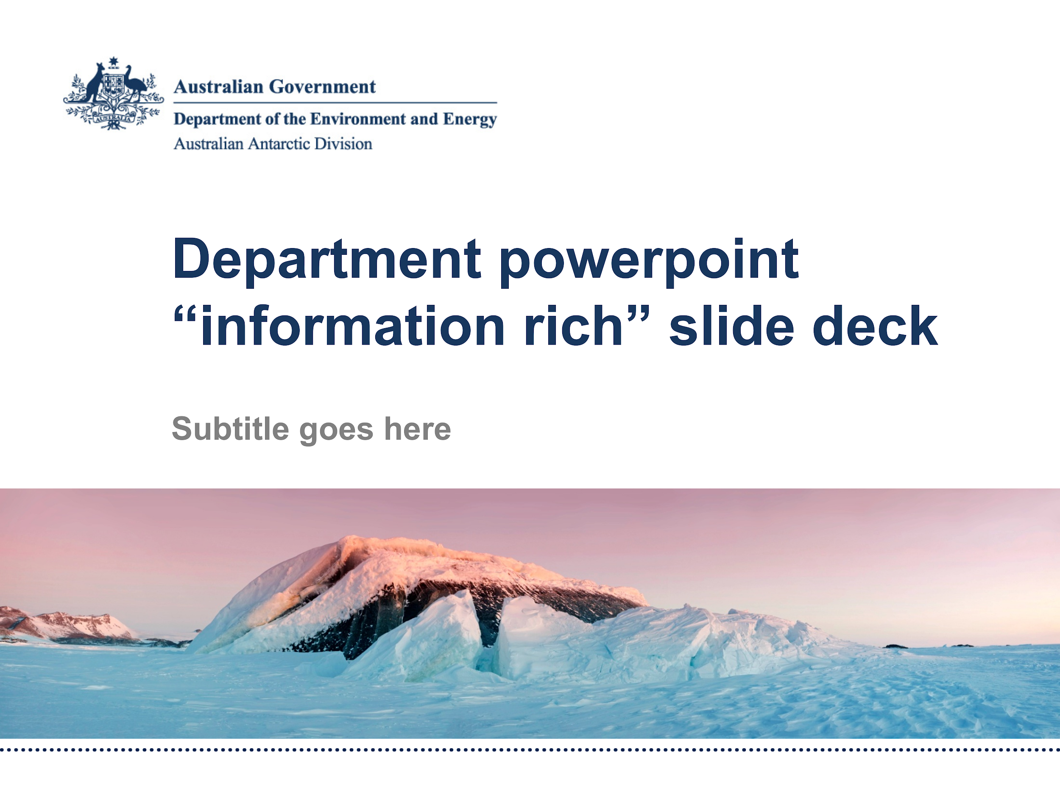


Coupled ice-sheet/ocean modelling
Ben Galton-Fenzi
ACCESS Science meeting, 13 September 2019

Slide 2
Outline
Coupled ice sheet/ocean modelling: status
Realistic Ice-ocean State Estimates (RISE)
Ice Sheet MIP for CMIP6 (ISMIP6)

Slide 3



Framework for Ice Sheet – Ocean Coupling (FISOC)
FISOC aims to provide a flexible coupling framework
Ocean model
Ice sheet model
Subglacial hydrology
ROMS
Elmer/Ice
Glads
FVCOM
Icepack
Permafrost/sediment model
Both implemented directly within Elmer. Coupling to ocean will be done through FISOC (but NYI).

Slide 4
Framework for Ice Sheet – Ocean Coupling (FISOC)
FISOC aims to provide a flexible coupling framework
Ocean model
Ice sheet model
Subglacial hydrology
ROMS
Elmer/Ice
Glads
FVCOM
Icepack
Permafrost/sediment model
Both implemented directly within Elmer. Coupling to ocean will be done through FISOC (but NYI).
MOM6 ?
?

Slide 5
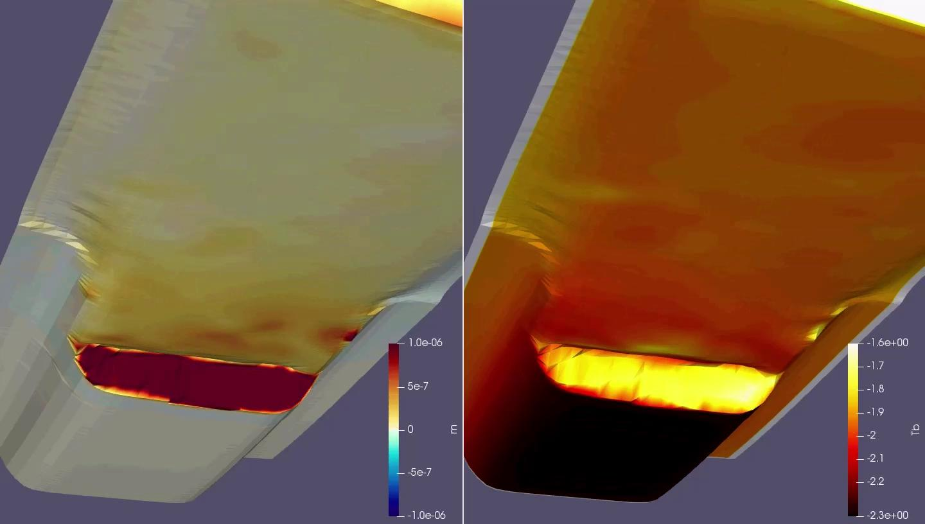
Idealised MISOMIP1 simulation - CliC targeted activity
ROMS melt and temperature projected on ice shelf lower surface in Elmer/ice

Slide 6
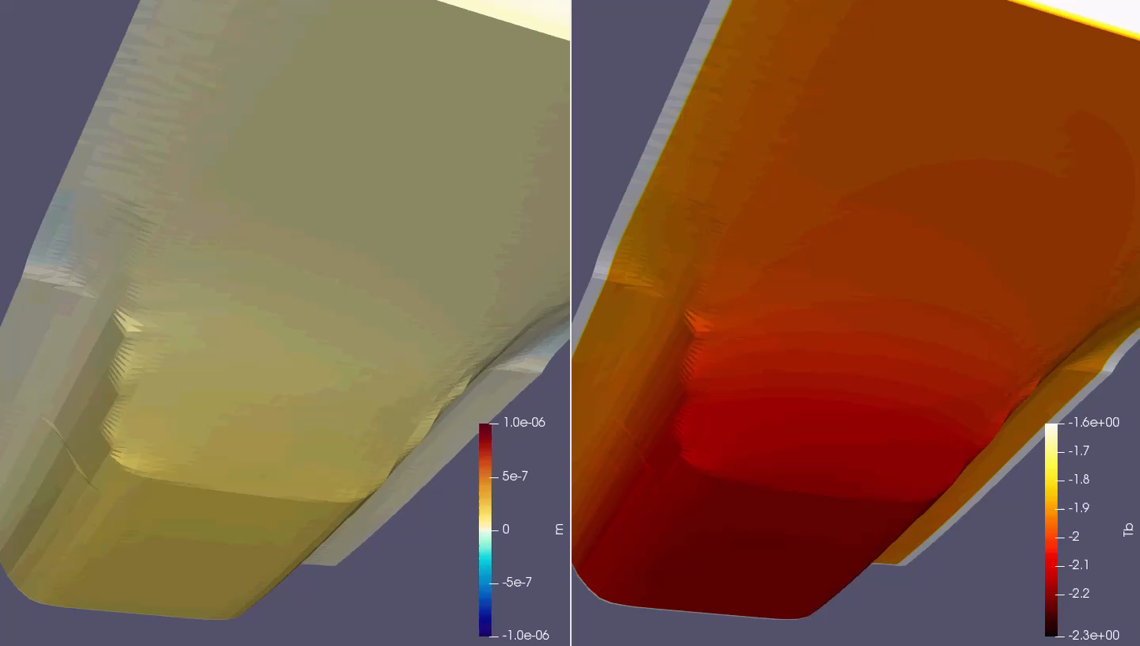
Idealised MISOMIP1 simulation
ROMS melt and temperature projected on ice shelf lower surface in Elmer/ice

Slide 7
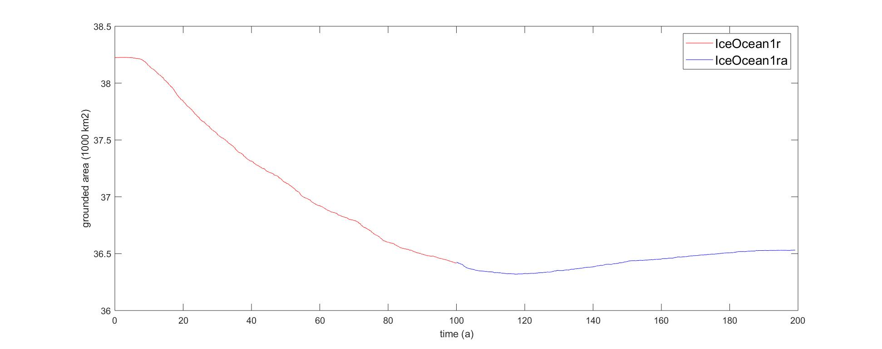
Idealised MISOMIP1 simulation
Grounded area evolution

Slide 8
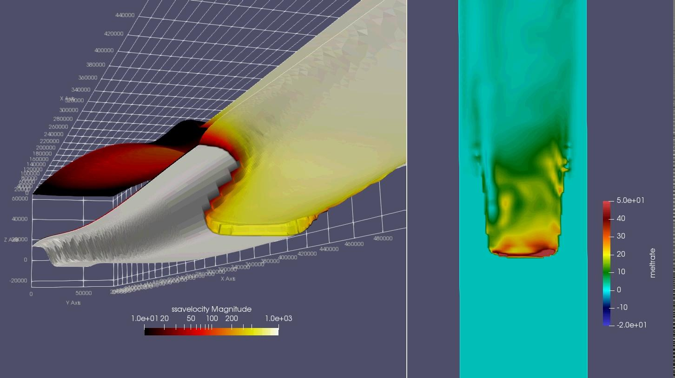
Idealised MISOMIP1 simulation
Grounded area evolution

Slide 9
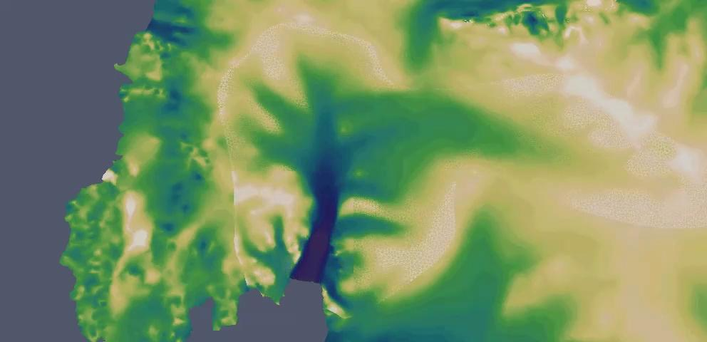
Whole-Antarctic coupling : Elmer/ice

Slide 10
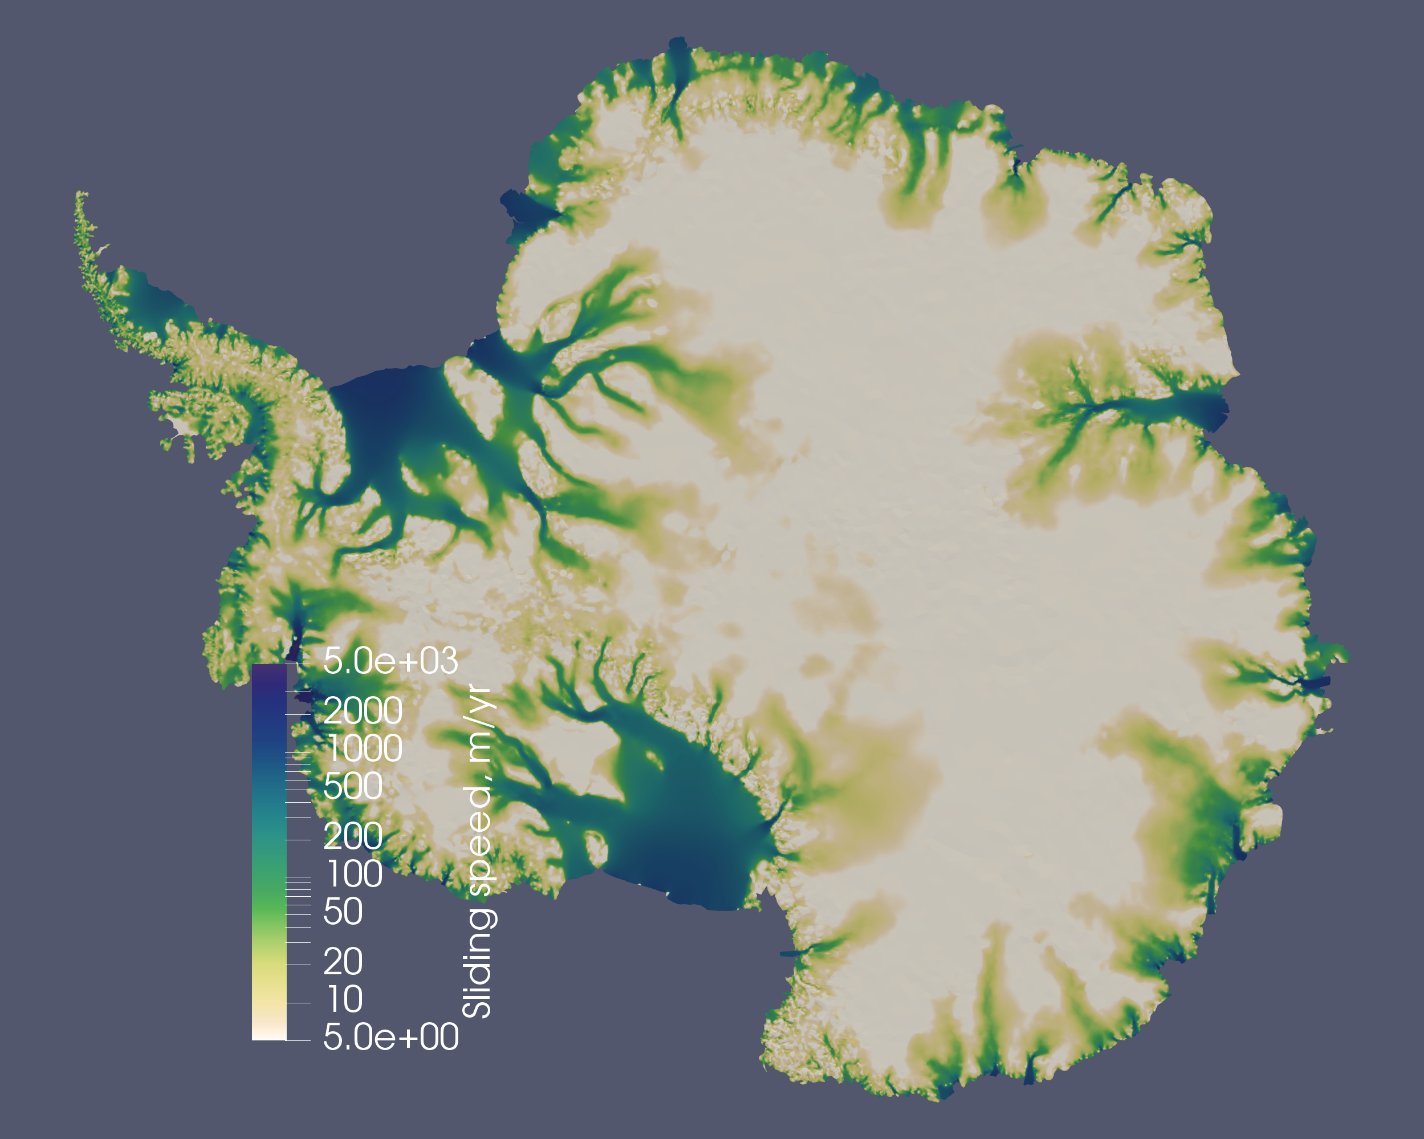
Whole-Antarctic coupling : Elmer/ice

Slide 11
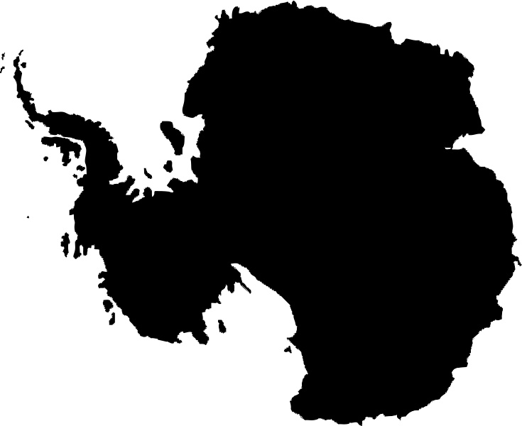
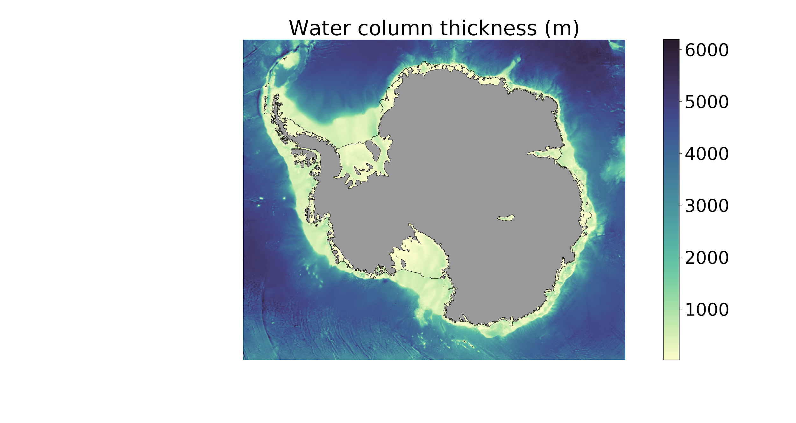
Antarctic Tidal Ocean Model, Ole Richter
Regional Ocean Modeling System 3.6
3 Eqn. melt parameterization + molecular diffusion alone
2 km resolution and 31 vertical layers, downscaling approach from 10 -> 4 -> 2 km
Realistic tides from TPXO 7.2
Surface forcing:
Daily buoyancy fluxes from observations (Tamura 2008)
Daily wind stress from Era-Interim 10-m winds
SST and SSS relaxed on long time scales to SOSE
We resolve tides, bathymetric troughs and eddies.
Notes:
Not resolving these three mechanisms considered as major shortcomings of previous large scale models
Step towards fully equipped model by designing new model
Key highlights and shortcomings of model design
Take home: Major improvement in terms of model physics compared to previous large scale models

Slide 12
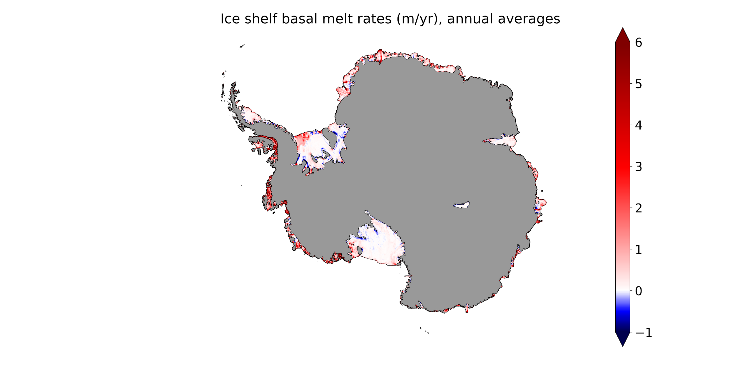
Antarctic basal melting
Melt regimes consistent with observations e.g. Rignot et al. (2013)
Resolves three melting modes:
Deep melting and refreezing
Melting at all depths
Ice front melting
Large scale melt pattern is realistic
Notes:
Mode 1 ...2 … 3
Amery (Galton-Fenzi 2012)
Fimbul high melt rates at deepest parts of draft (Hatterman 2014 high res )
SW FRIS dominated by meltwater plume convection (Paul Holland 2007 2D plume model)
Amundsen-Bellingshausen Seas strong melting (many)
Ross front melting (Arzeno 2014 oceanographic and GPS data)
Totten high melt rates (Gwyther 2014 regional model)

Slide 13
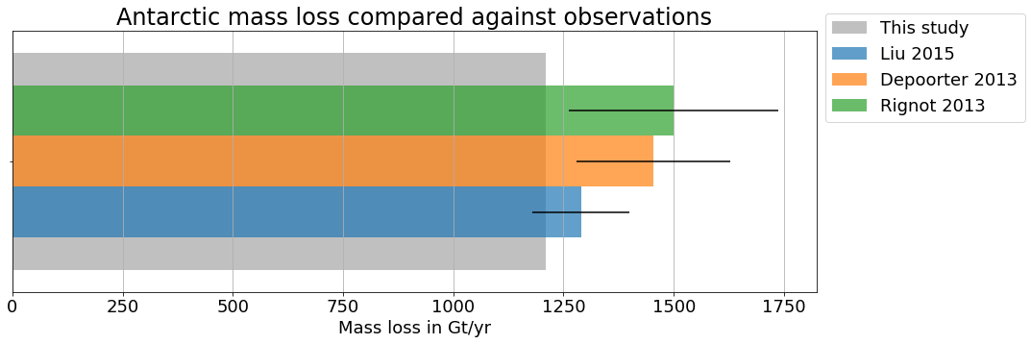
ATOM: Total basal mass loss: 1209 Gt/yr
Total basal mass loss agrees with observations
Notes:
total Antarctic mass loss estimate is spot on!

Slide 14
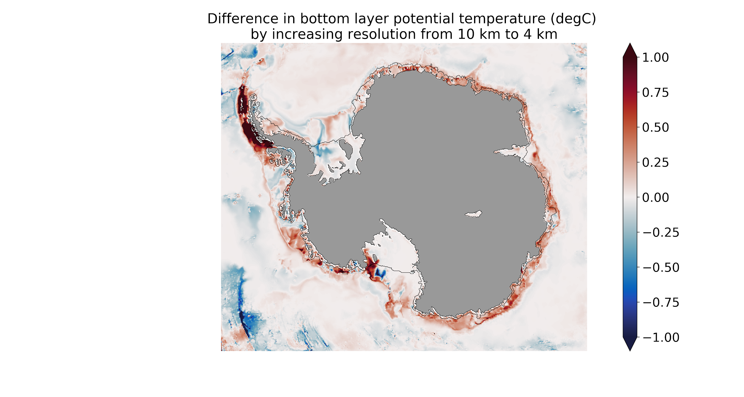
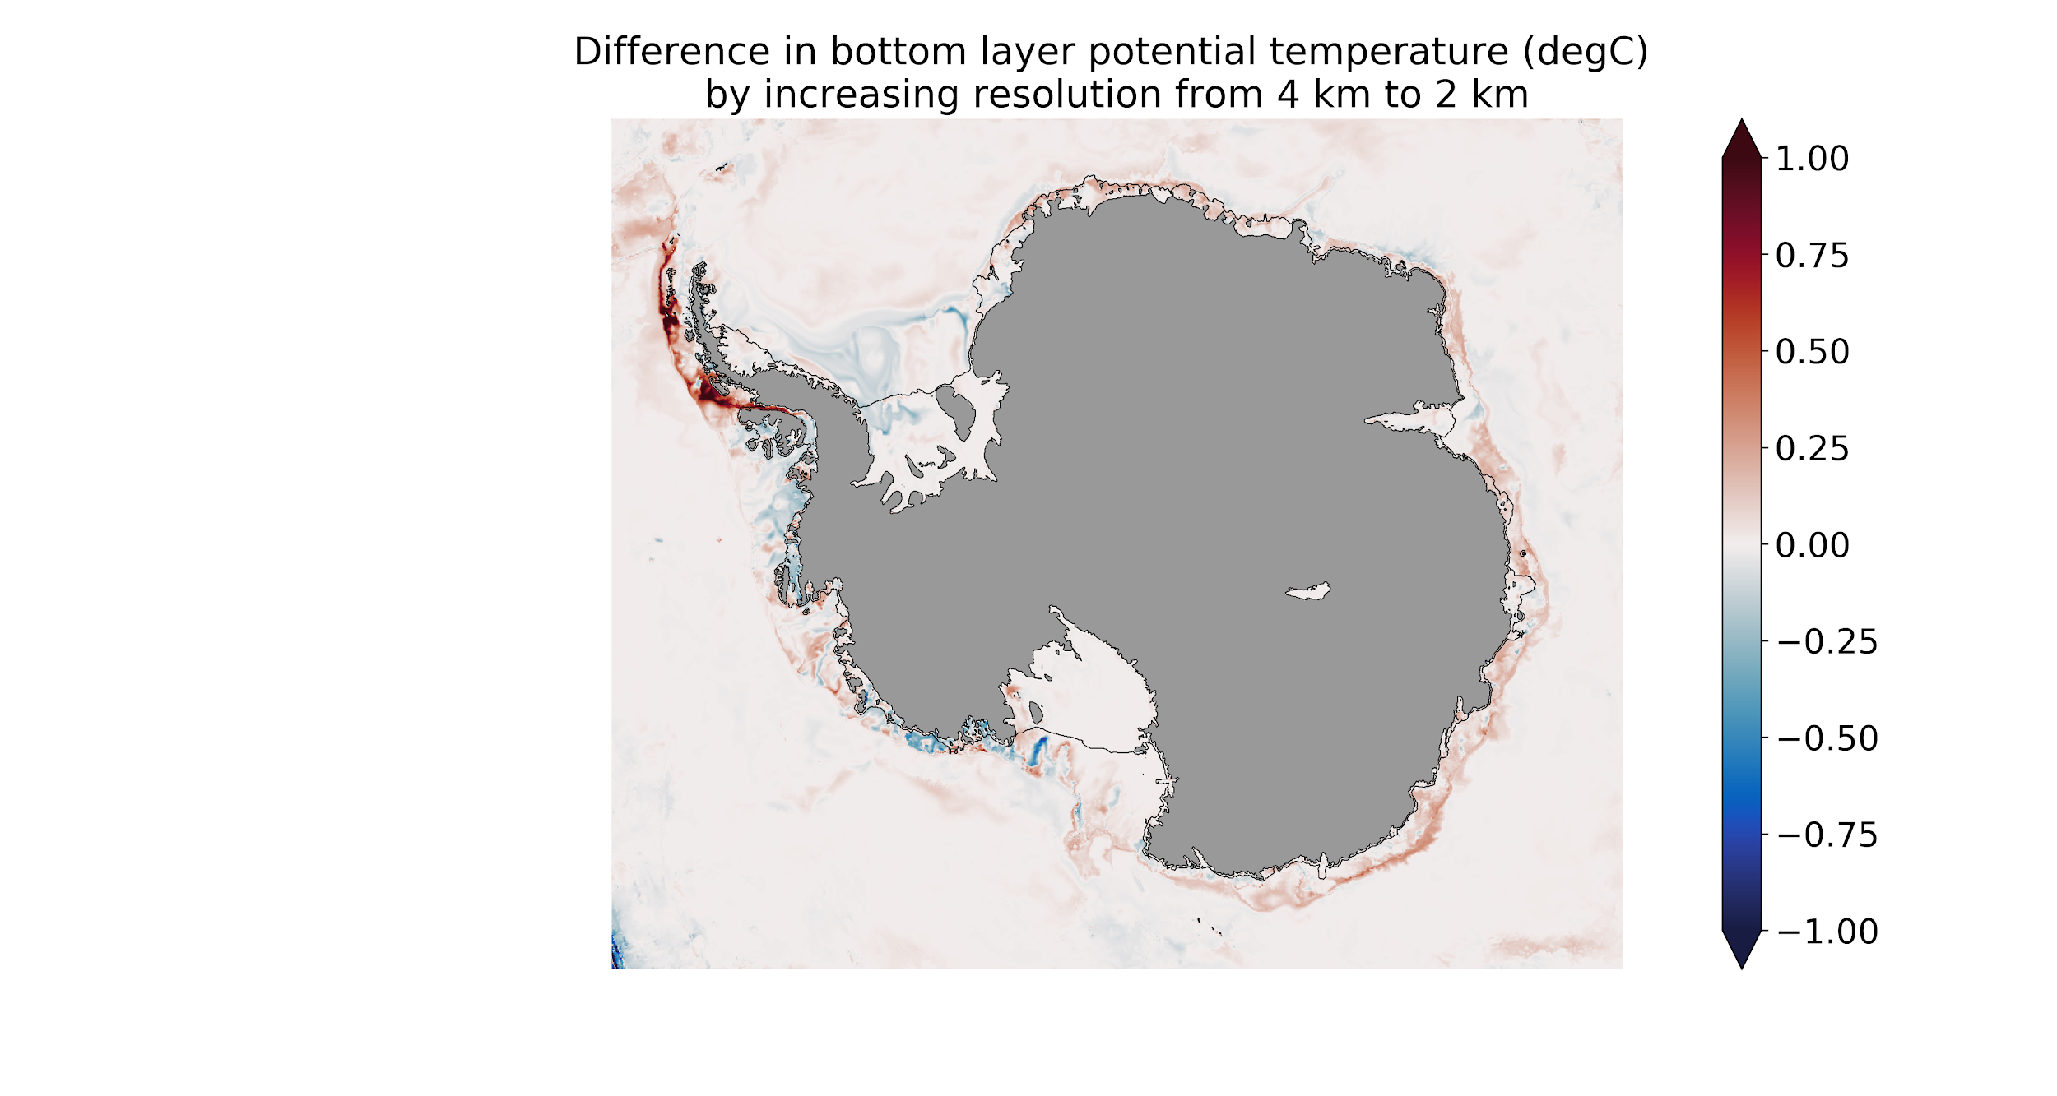
Example: resolution dependence
10 km - 4 km
4 km - 2 km
Many more warm water intrusions at 4 km
Are bathymetric troughs more important than eddies?
2 km - 1 km ?
Richter et al. in-prep.

Slide 15
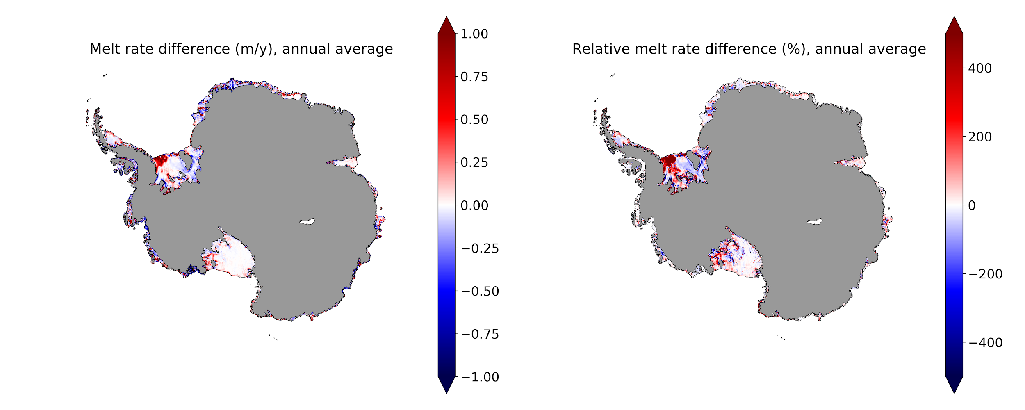
Example: influence of physical processes, e.g. tides
(Tides - No_Tides) / Tides
Tides - No_Tides
Large impact on cold water ice shelves
Which tidal melt mechanisms contribute most?
Integrated effect small: 57 Gt/yr (4%)
Richter et al. in-prep.

Slide 16




Realistic Ice-Ocean State Estimates (RISE)
Motivation:
Ocean-driven Antarctic mass loss large uncertainty in future SLR
No broad-scale comparison and evaluation of ocean-ice sheet interaction models and observations exist
Aims:
A coordinated multi-model comparison of ice-shelf/ocean models, before comparing ice sheet models and then coupled models.
Integration and coordination between modelling and observational studies
Improve detection and attribution of ice sheet mass change and ocean state.

Slide 17
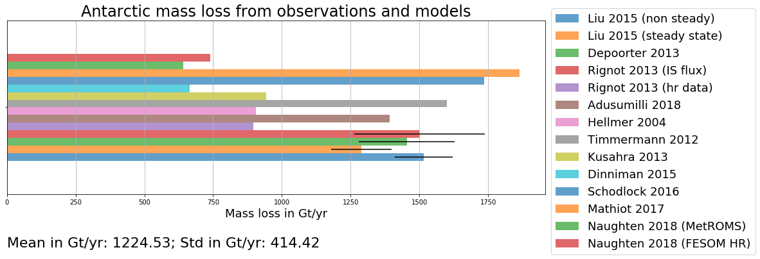
RISE : Realistic Ice-ocean State Estimates
Graph by Ole Richter
Huge range of estimates
Intercomparison projects (e.g. MISOMIP and ISMIP6 WCRP-CliC targeted activity) bring together the international ice sheet-ocean modelling community
Combine observational and modelling effort for better integration of knowledge and cooperation regarding circum-Antarctic ocean-driven melting
Notes:
Slide by Ole R.
large variability between published models and satellite estimates → therefore the need to compare and understand these differences to better estimate! -- identify the regions of high variability (variability in the estimated mass loss buy the different methods/models/…) to better understand local processes and methods used to calculate the melt rate
Current model inter-comparison efforts, such as MISOMIP and ISMIP6 WCRP-CliC targeted activity: brings together the wide international ice sheet-ocean modelling community to design and carry out an ensemble of simulations that project the future of WAIS

Slide 18




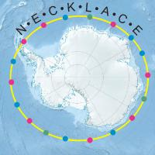





Realistic Ice-ocean State Estimates (RISE)
Steering committee:
Ben Galton-Fenzi (Australian Antarctic Division)
Helen Amanda Fricker (SCRIPPS Institution of Oceanography)
David Holland (New York University)
Keith Nicholls (British Antarctic Survey)
Hélène Séroussi (Caltech’s Jet Propulsion Laboratory)
Louise Newman (Southern Ocean Observing System)

Slide 19
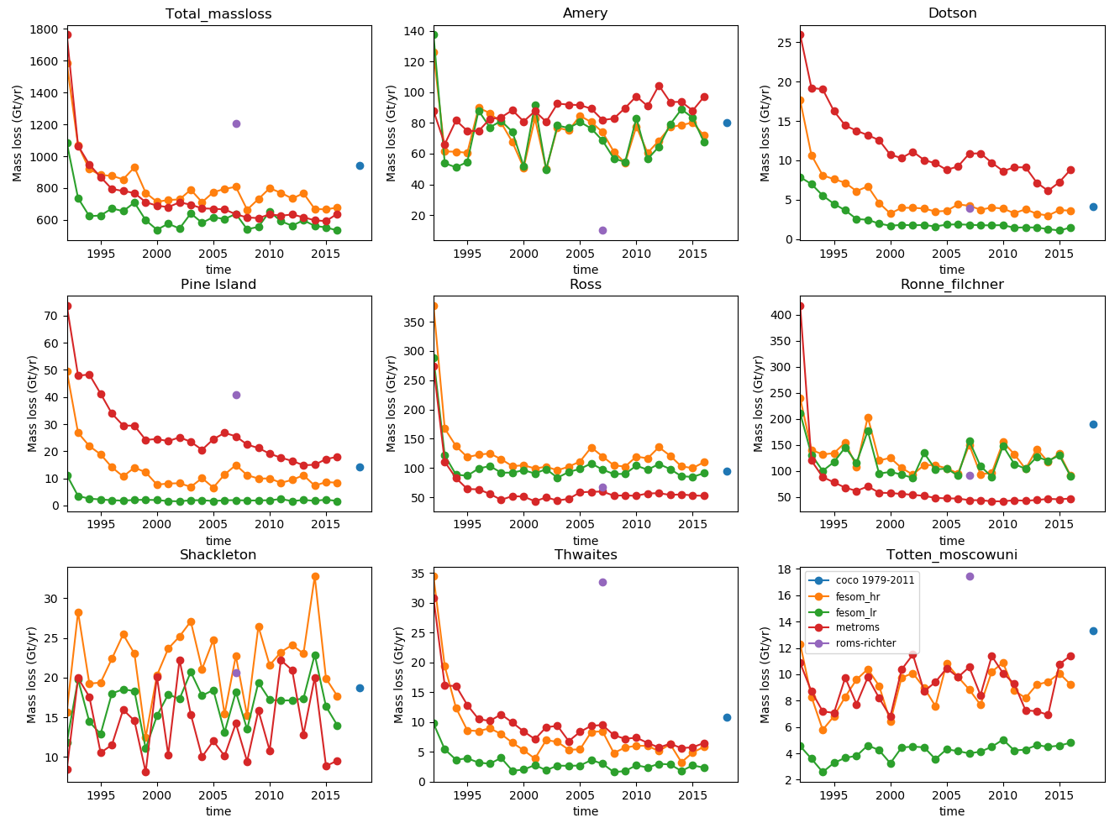
Ocean Model | Host Institute
MOM6 | GFDL, USA
MITgcm/ECCO2 | JPL, USA
MITgcm | BAS, UK
FESOM | AWI, Germany
BRIOS | AWI, Germany
POP2X / MPAS-O | LANL/Potsdam, USA/Germany
MetROMS - CAISOM | MetNO/ACE CRC, Norway/Australia
COCO | ACE CRC/AORI, Australia/Japan
NEMO | Grenoble, France
ROMS - ACIMA | ODU, USA
Emulator | LANL/Potsdam, USA/Germany
RISE: contributing models

Slide 20
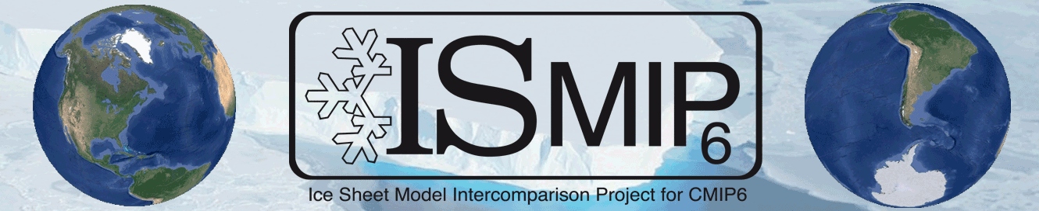
ISMIP6 ( Ice Sheet Model Intercomparison for CMIP6)
CliC targeted activity
Bring ice sheet model intercomparisons in line with CMIP community
Feedbacks and forcings from Atmosphere-Ocean-GCMs
Uses basal melting parameterisations/downscaling for ice sheet models for ocean forcings

Slide 21
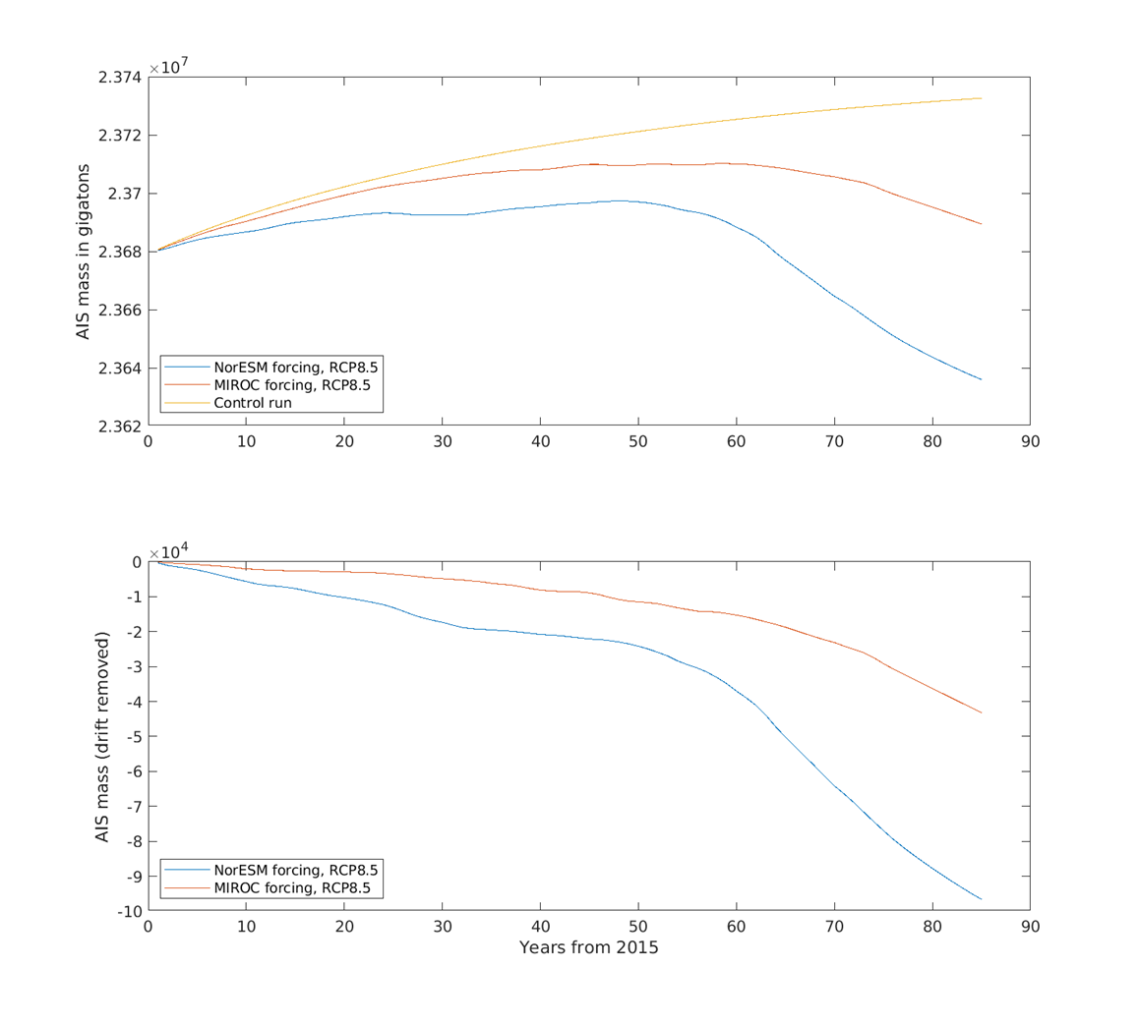
ISMIP6 projections - Elmer\ice
ISMIP6 control and two projection experiments from 2015 to 2100

Slide 22

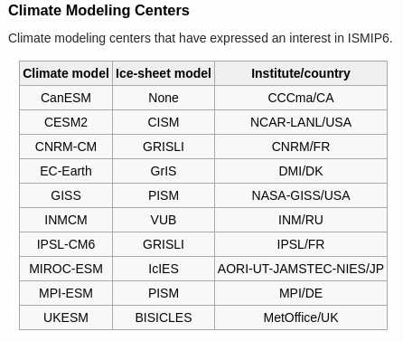

Slide 23
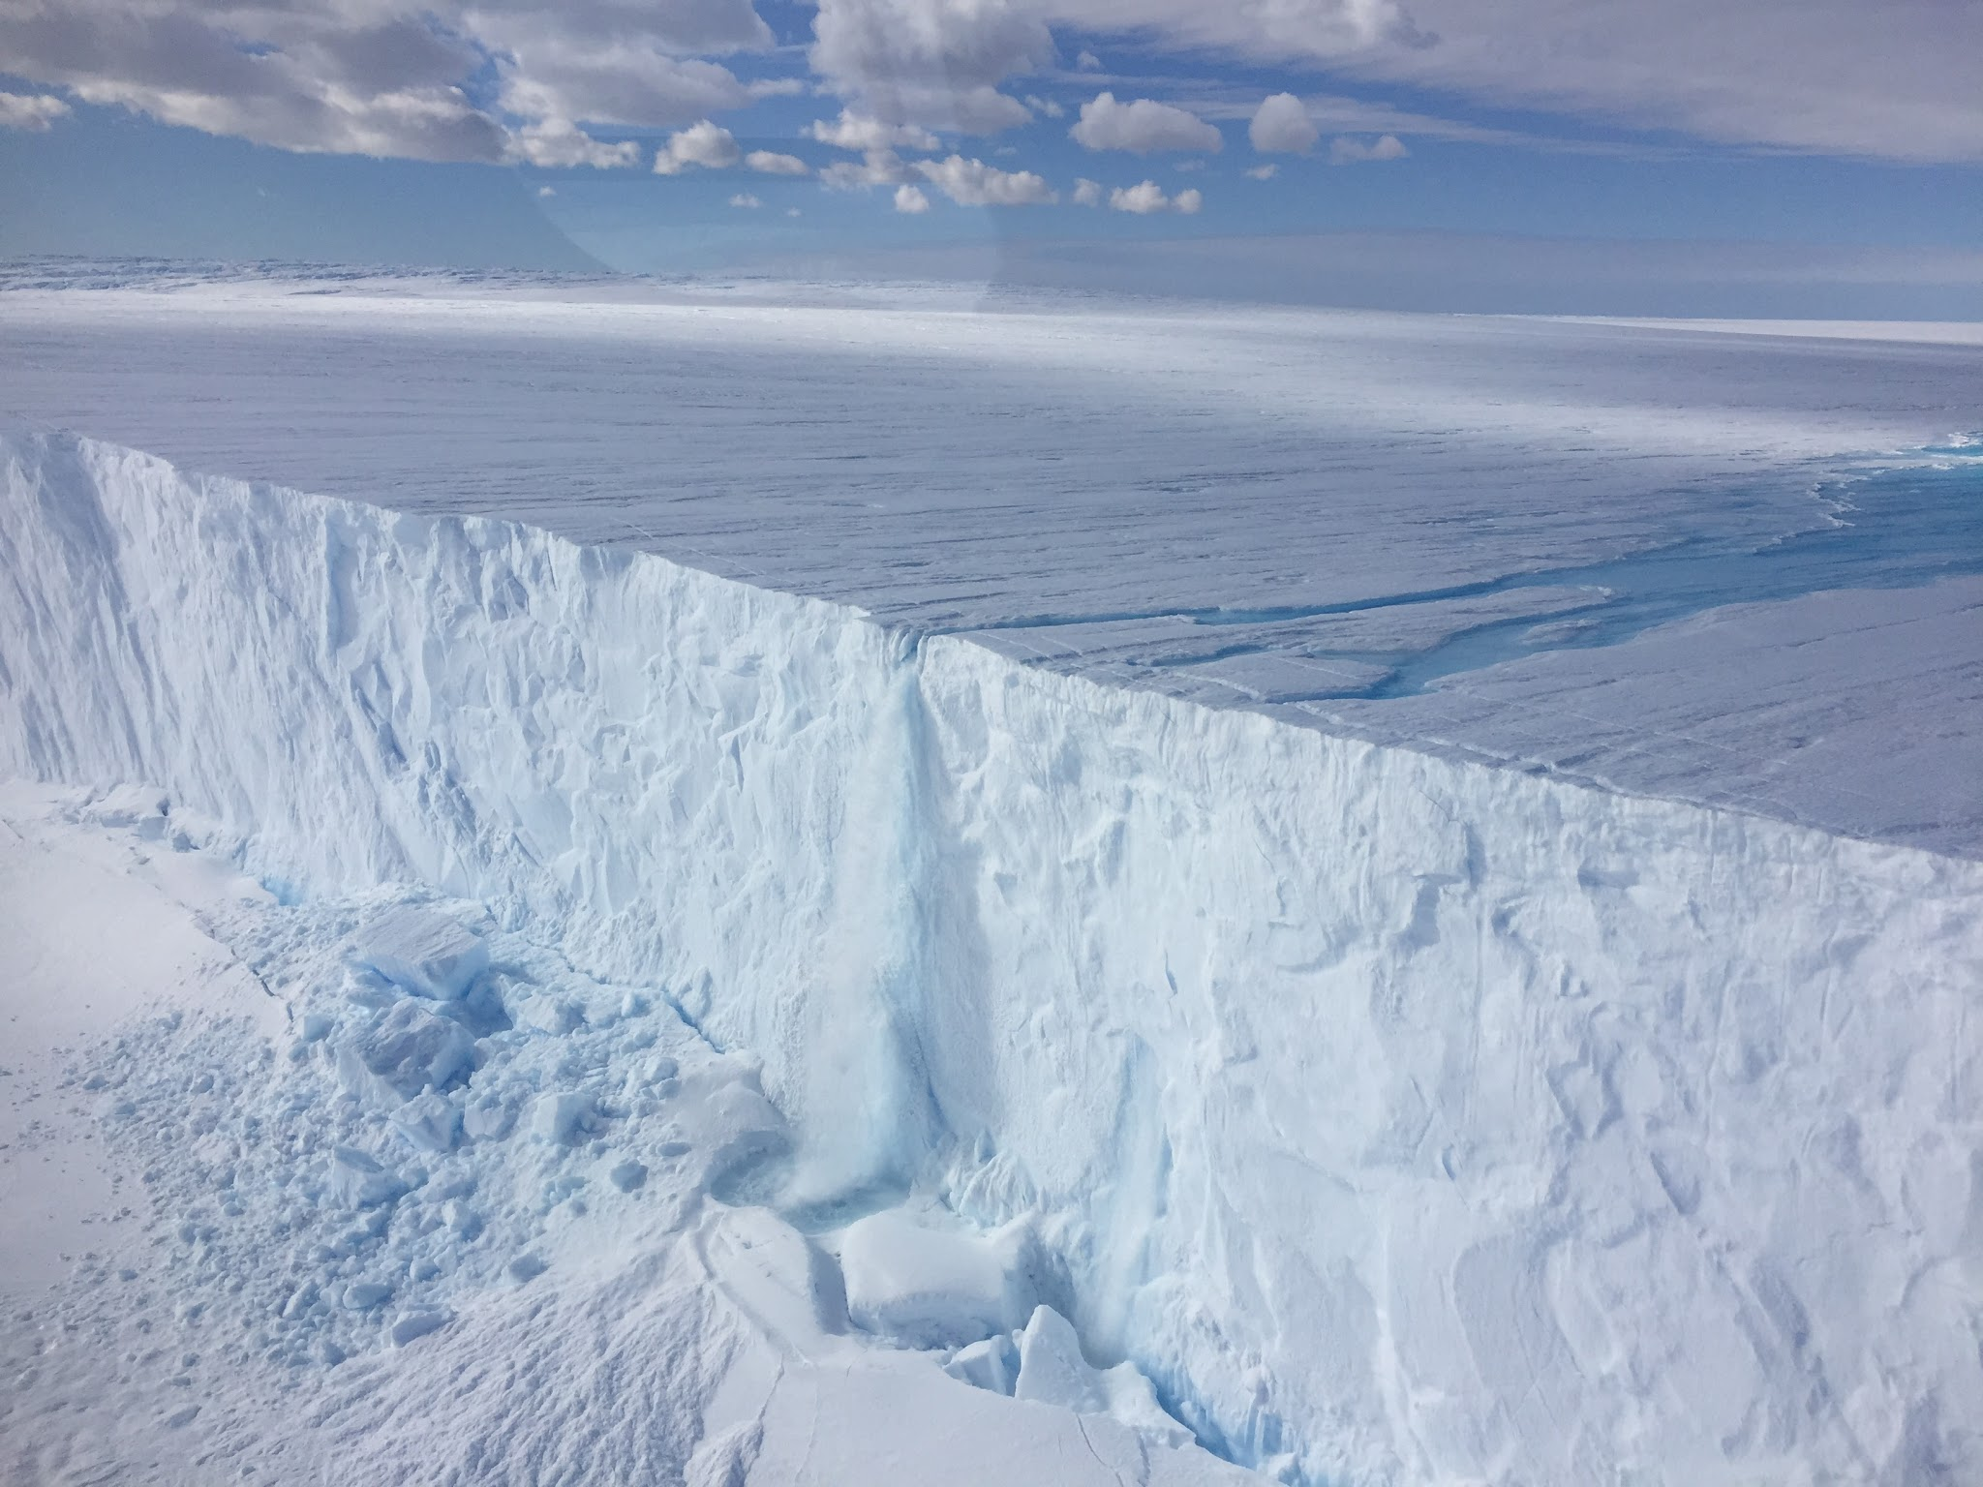

Slide 24
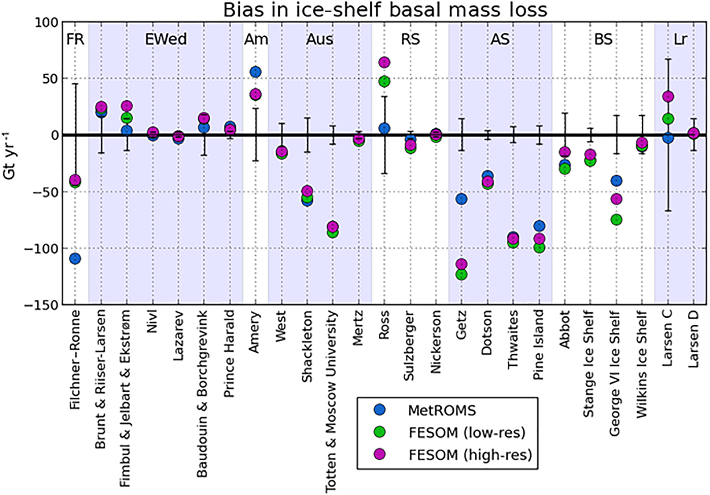
Example: Comparison of bias in basal mass loss
Naughten et al. 2018. GMD.

Slide 25
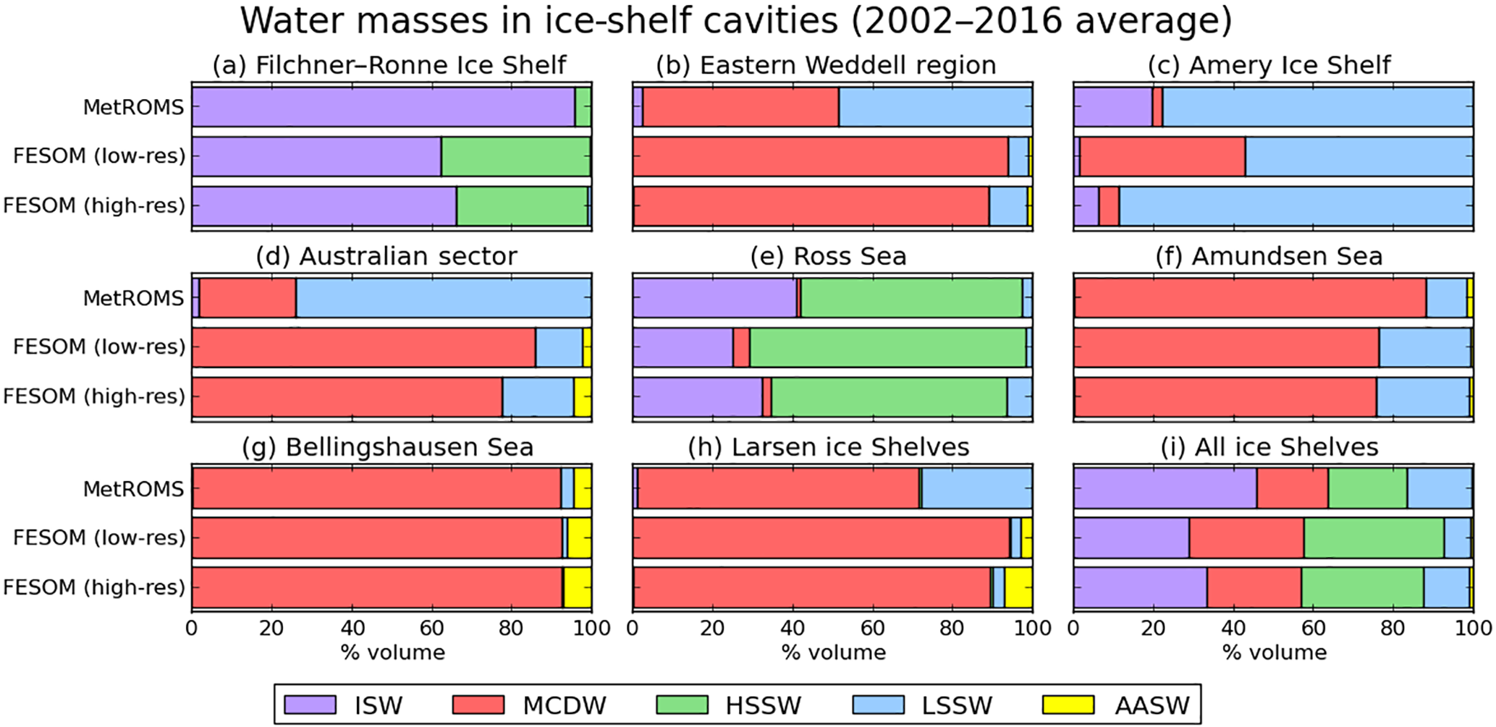
Example: Comparison of water mass properties
Naughten et al. 2018. GMD.

Slide 26
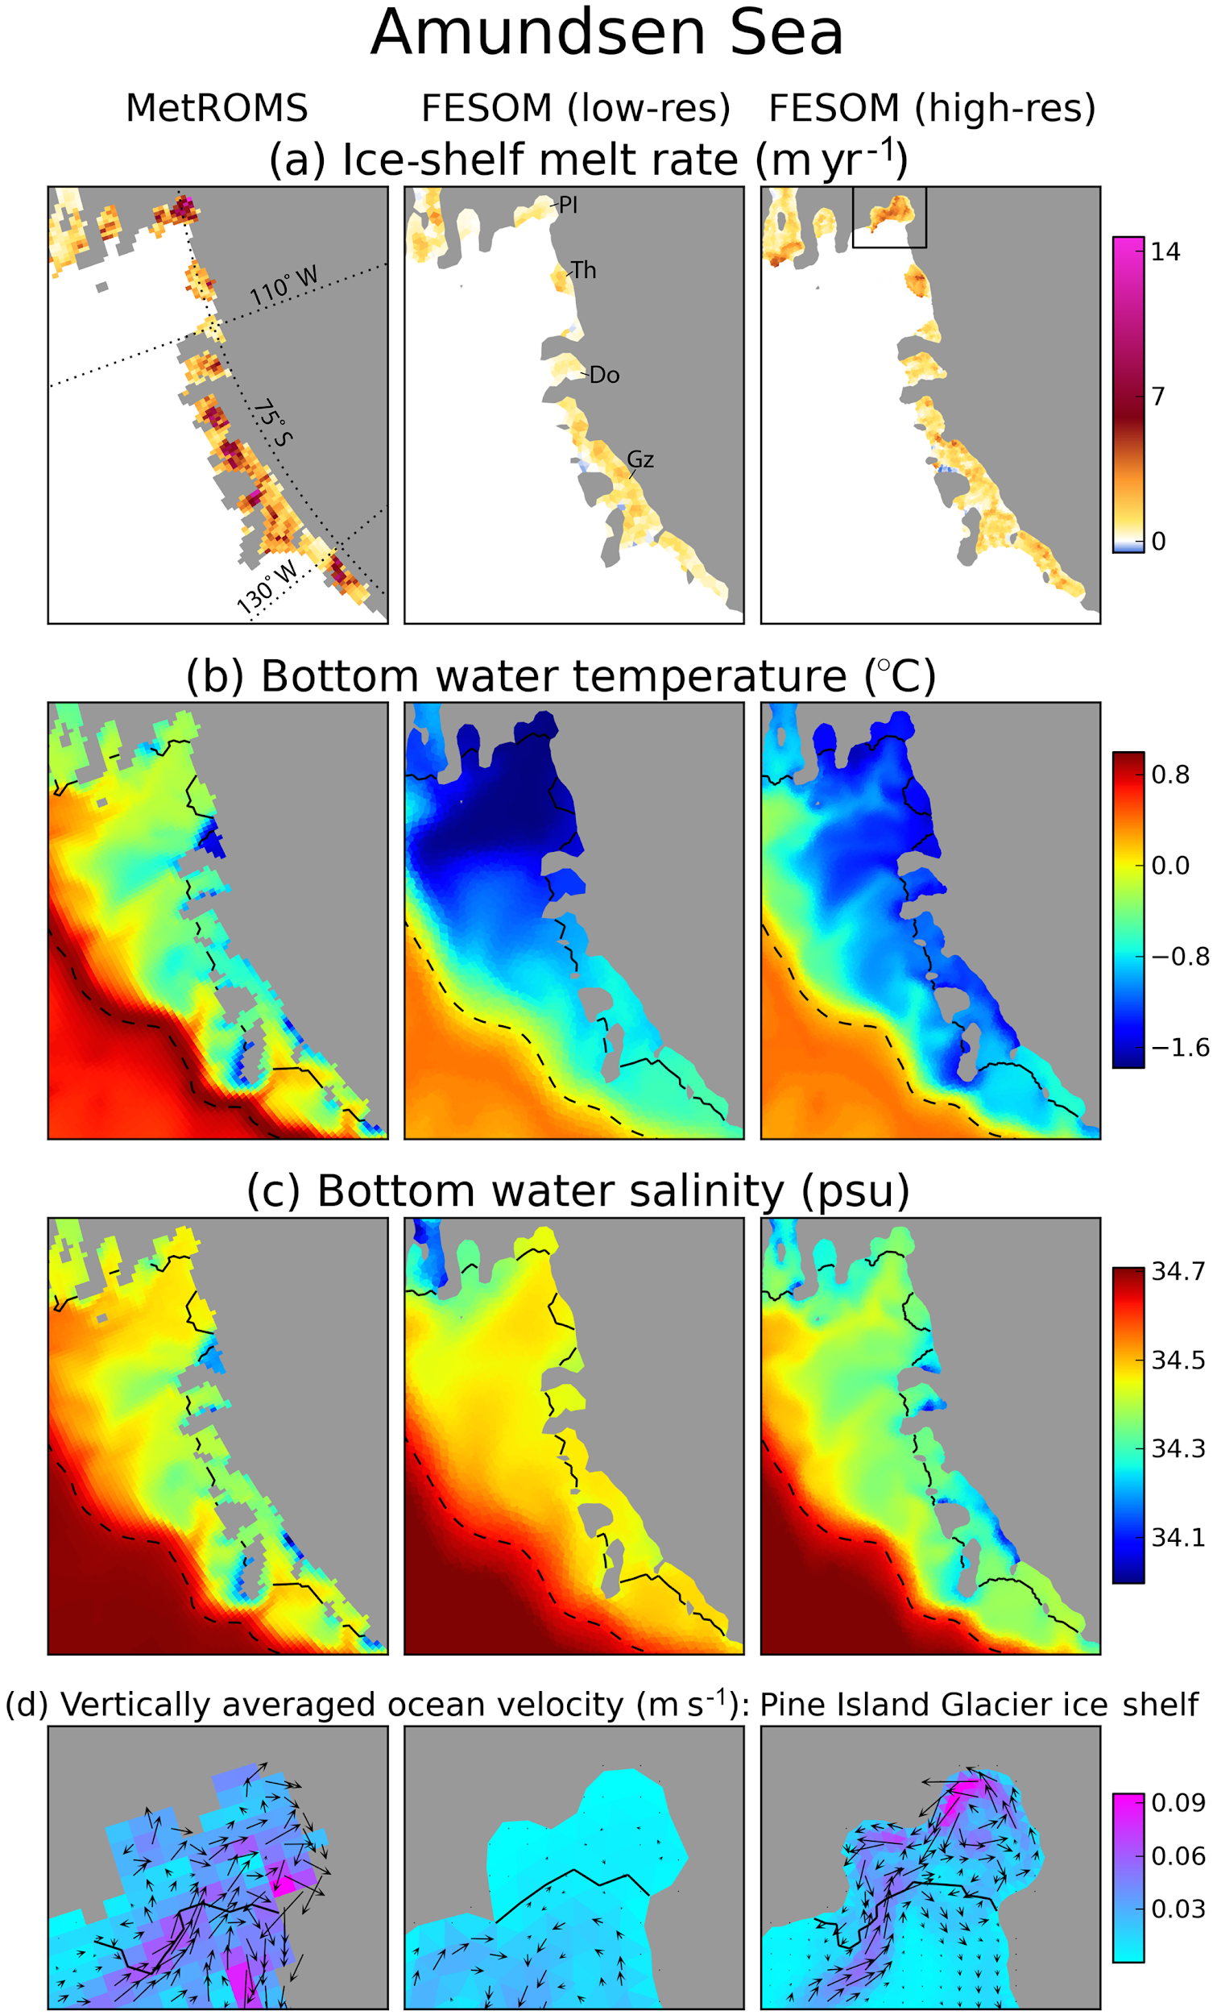
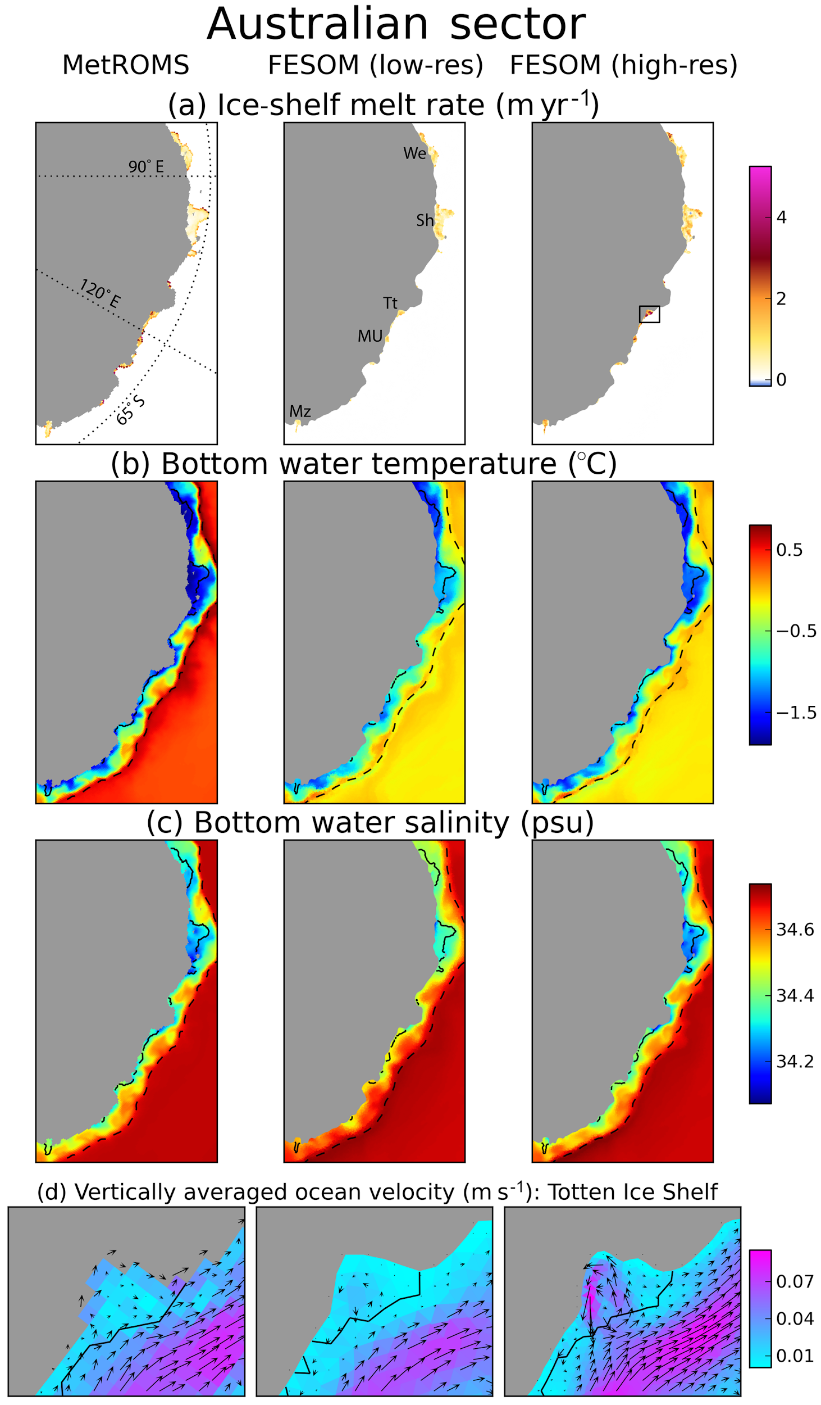
Naughten et al. 2018. GMD.

